Slide 1
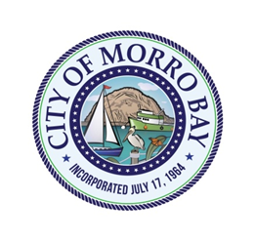
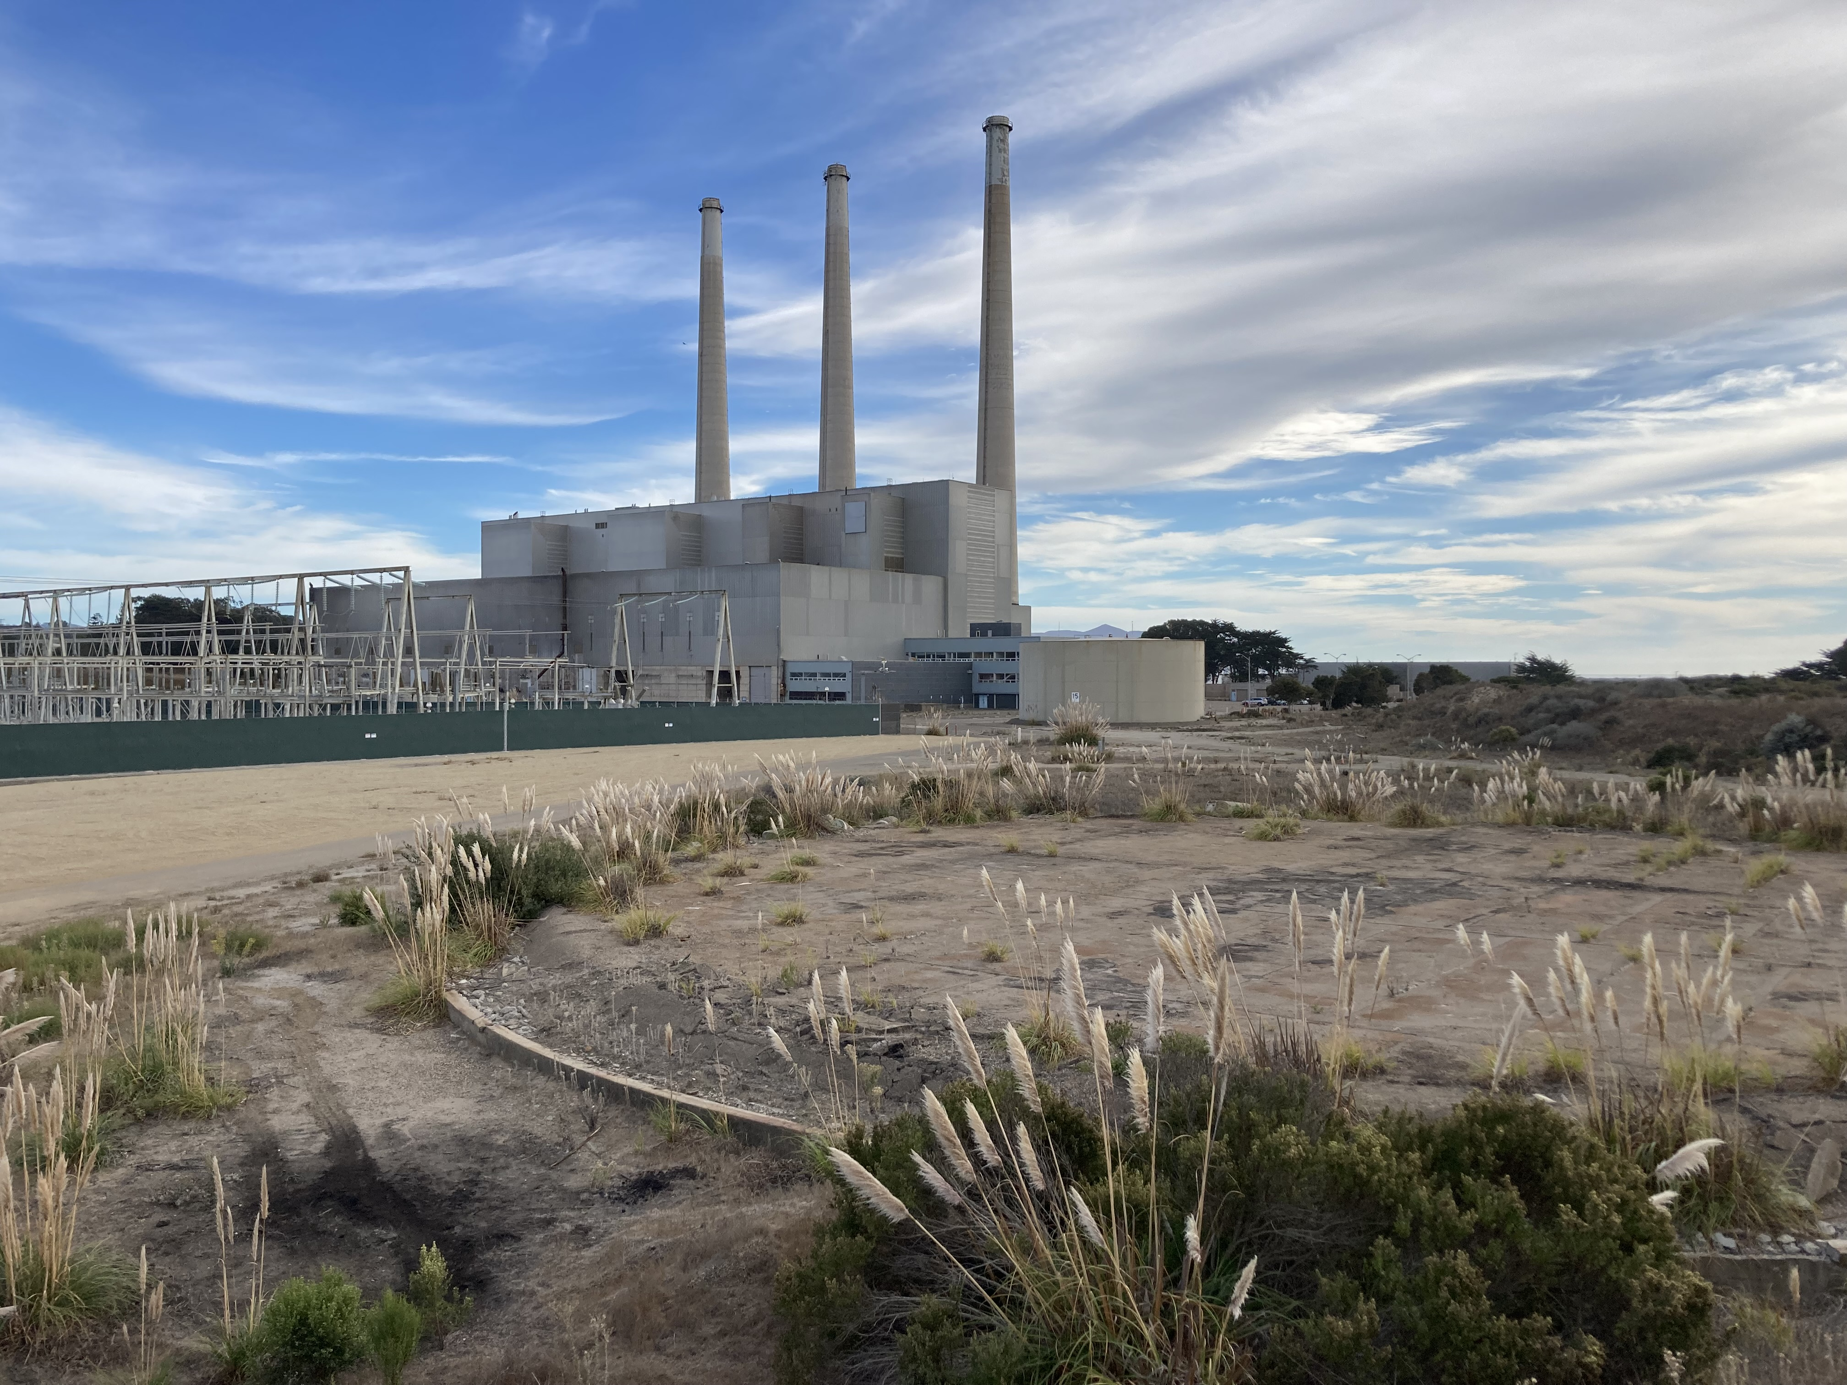
Planning Commission
Workshop to Receive Public Comments on the Draft EIR for the Vistra BESS Project (CDP20-026/CUP20-14), Morro Bay Power Company LLC
May 7, 2024

Slide 2
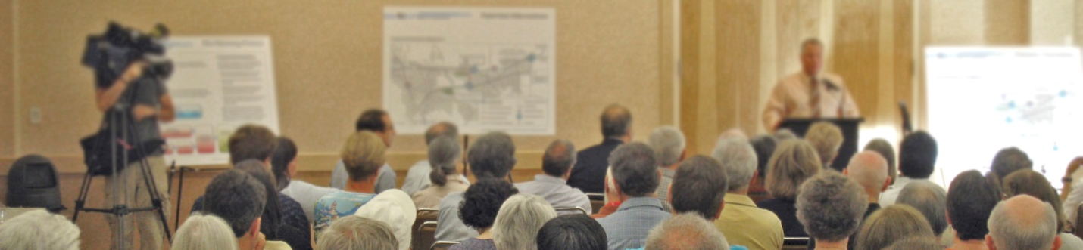
Purpose of the Public Workshop
Provide members of the public, organizations, and interested public agencies an opportunity to make comments on issues related to the Draft Environmental Impact Report (Draft EIR) for the Vistra BESS Project (CDP20-026/CUP20-14).

Slide 3
Public Workshop Agenda
Project Overview
Overview of the Draft EIR
The EIR Process
DEIR Key Topics and Conclusions
Next Steps in the EIR Process
Public Comments on the Draft EIR

Slide 4
Project Overview
600-MW Battery Energy Storage System facility (BESS Facility) on the former tank farm portion of the property
Demolition and removal of the existing power plant building and stacks
Master Plan
Land use designation and zoning change
Required by PMB Policy LU-5.4 and Coastal Commission

Slide 5
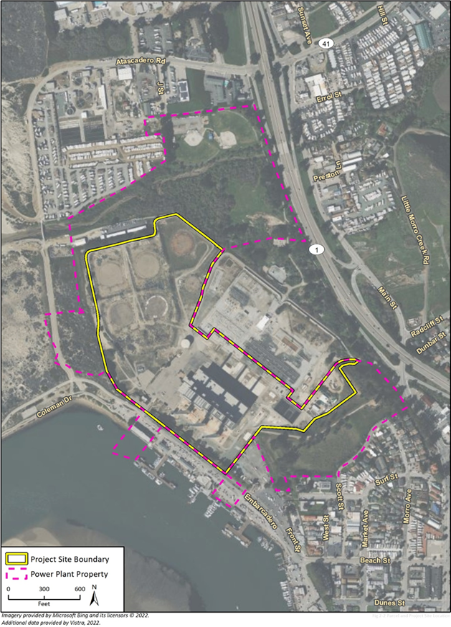
Power Plant Property and Project Site
107-acre Morro Bay Power Plant Property
43-acre Project Site: portion that would be used for the proposed project
Current land use designation:
Visitor Serving Commercial with Mixed-Use Residential Overlay (Plan Morro Bay)
Current zoning :
Visitor Serving Commercial (updated from former Industrial - M-2/PD/I)

Slide 6
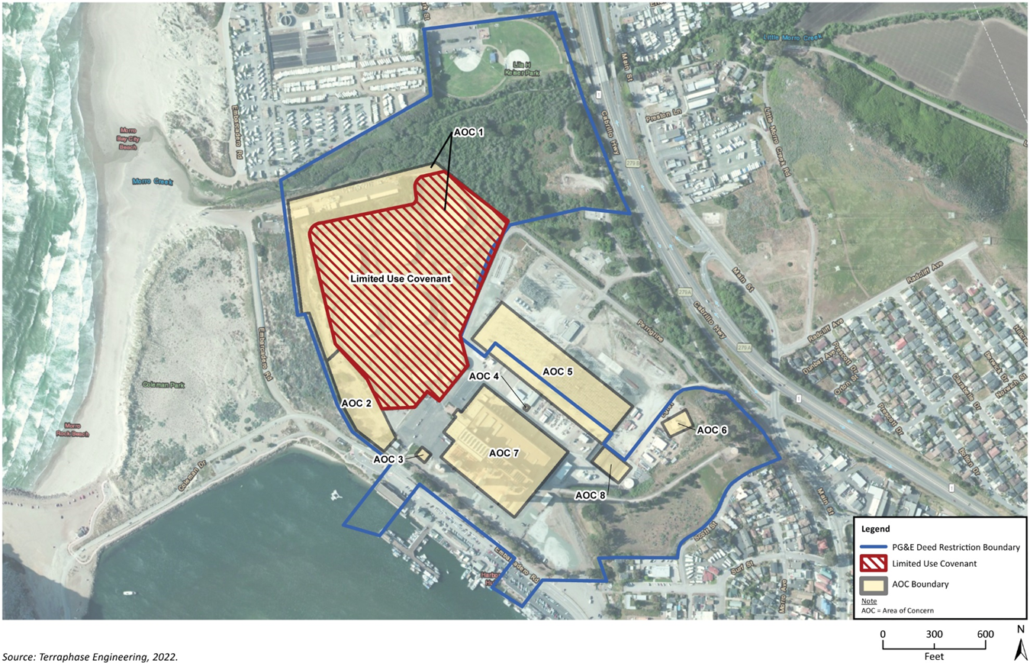
Project Site – Current Land Use Restrictions
PG&E deed restriction limits land uses on the Power Plant site (including the Project Site
DTSC LUC restricts land use on former tank farm (AOC 1) to commercial/industrial uses

Slide 7
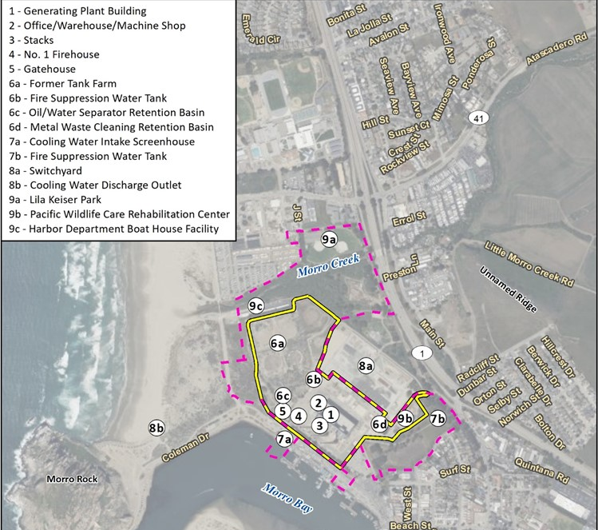
Existing Features of the Property
Regionally accessible from Highway 1
Locally accessible from Main Street, Beach Street, Embarcadero, and Quintana Road
Former Tank Farm site is vacant, but was previously developed with above-ground storage tanks
2.75-acre driveway connects Project Site to Quintana Road

Slide 8
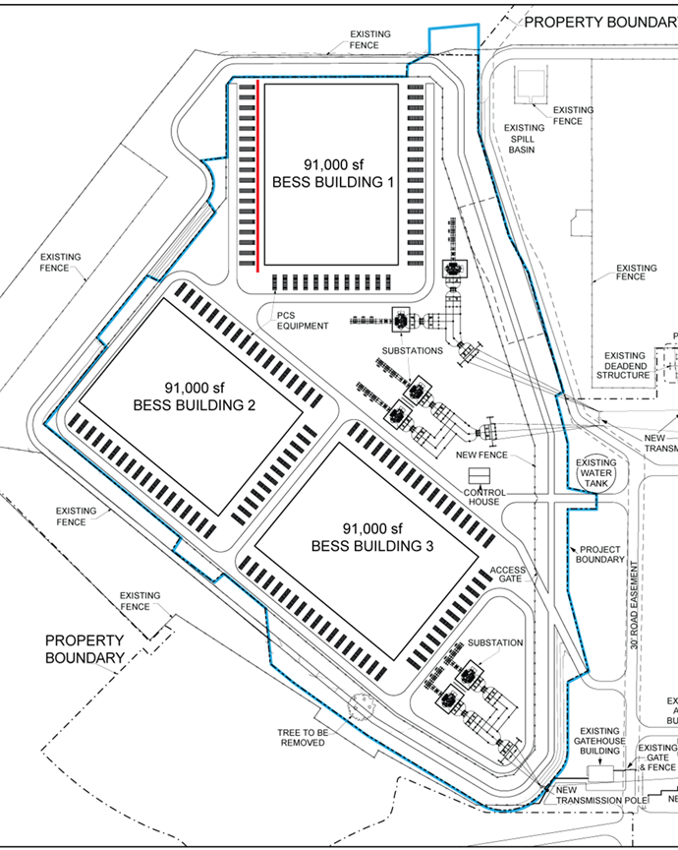
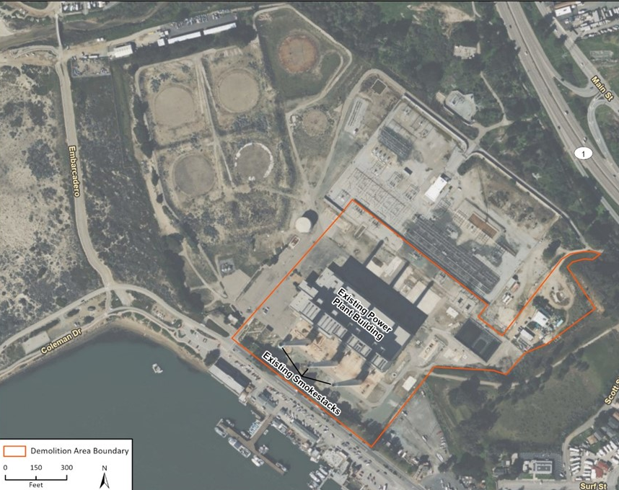
BESS Site and Demolition Site
24-acre BESS Site: construction and operation of the proposed BESS Facility and supporting facilities
19-acre Demolition Site: demolition of the idled Power Plant building and stacks

Slide 9
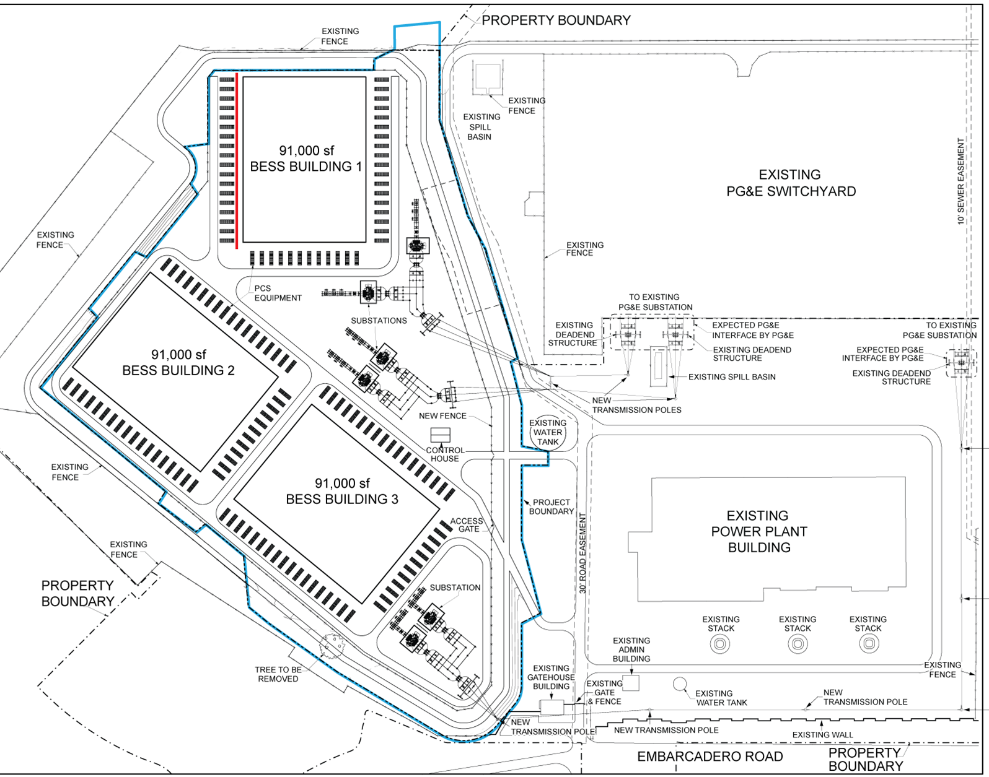
BESS Facility Site Plan & Components
BESS Facility includes:
Three two-story buildings to house batteries, each with a PCS, substation, and fire suppression system
Connection to the existing PG&E switchyard
Frontage improvements on Embarcadero

Slide 10
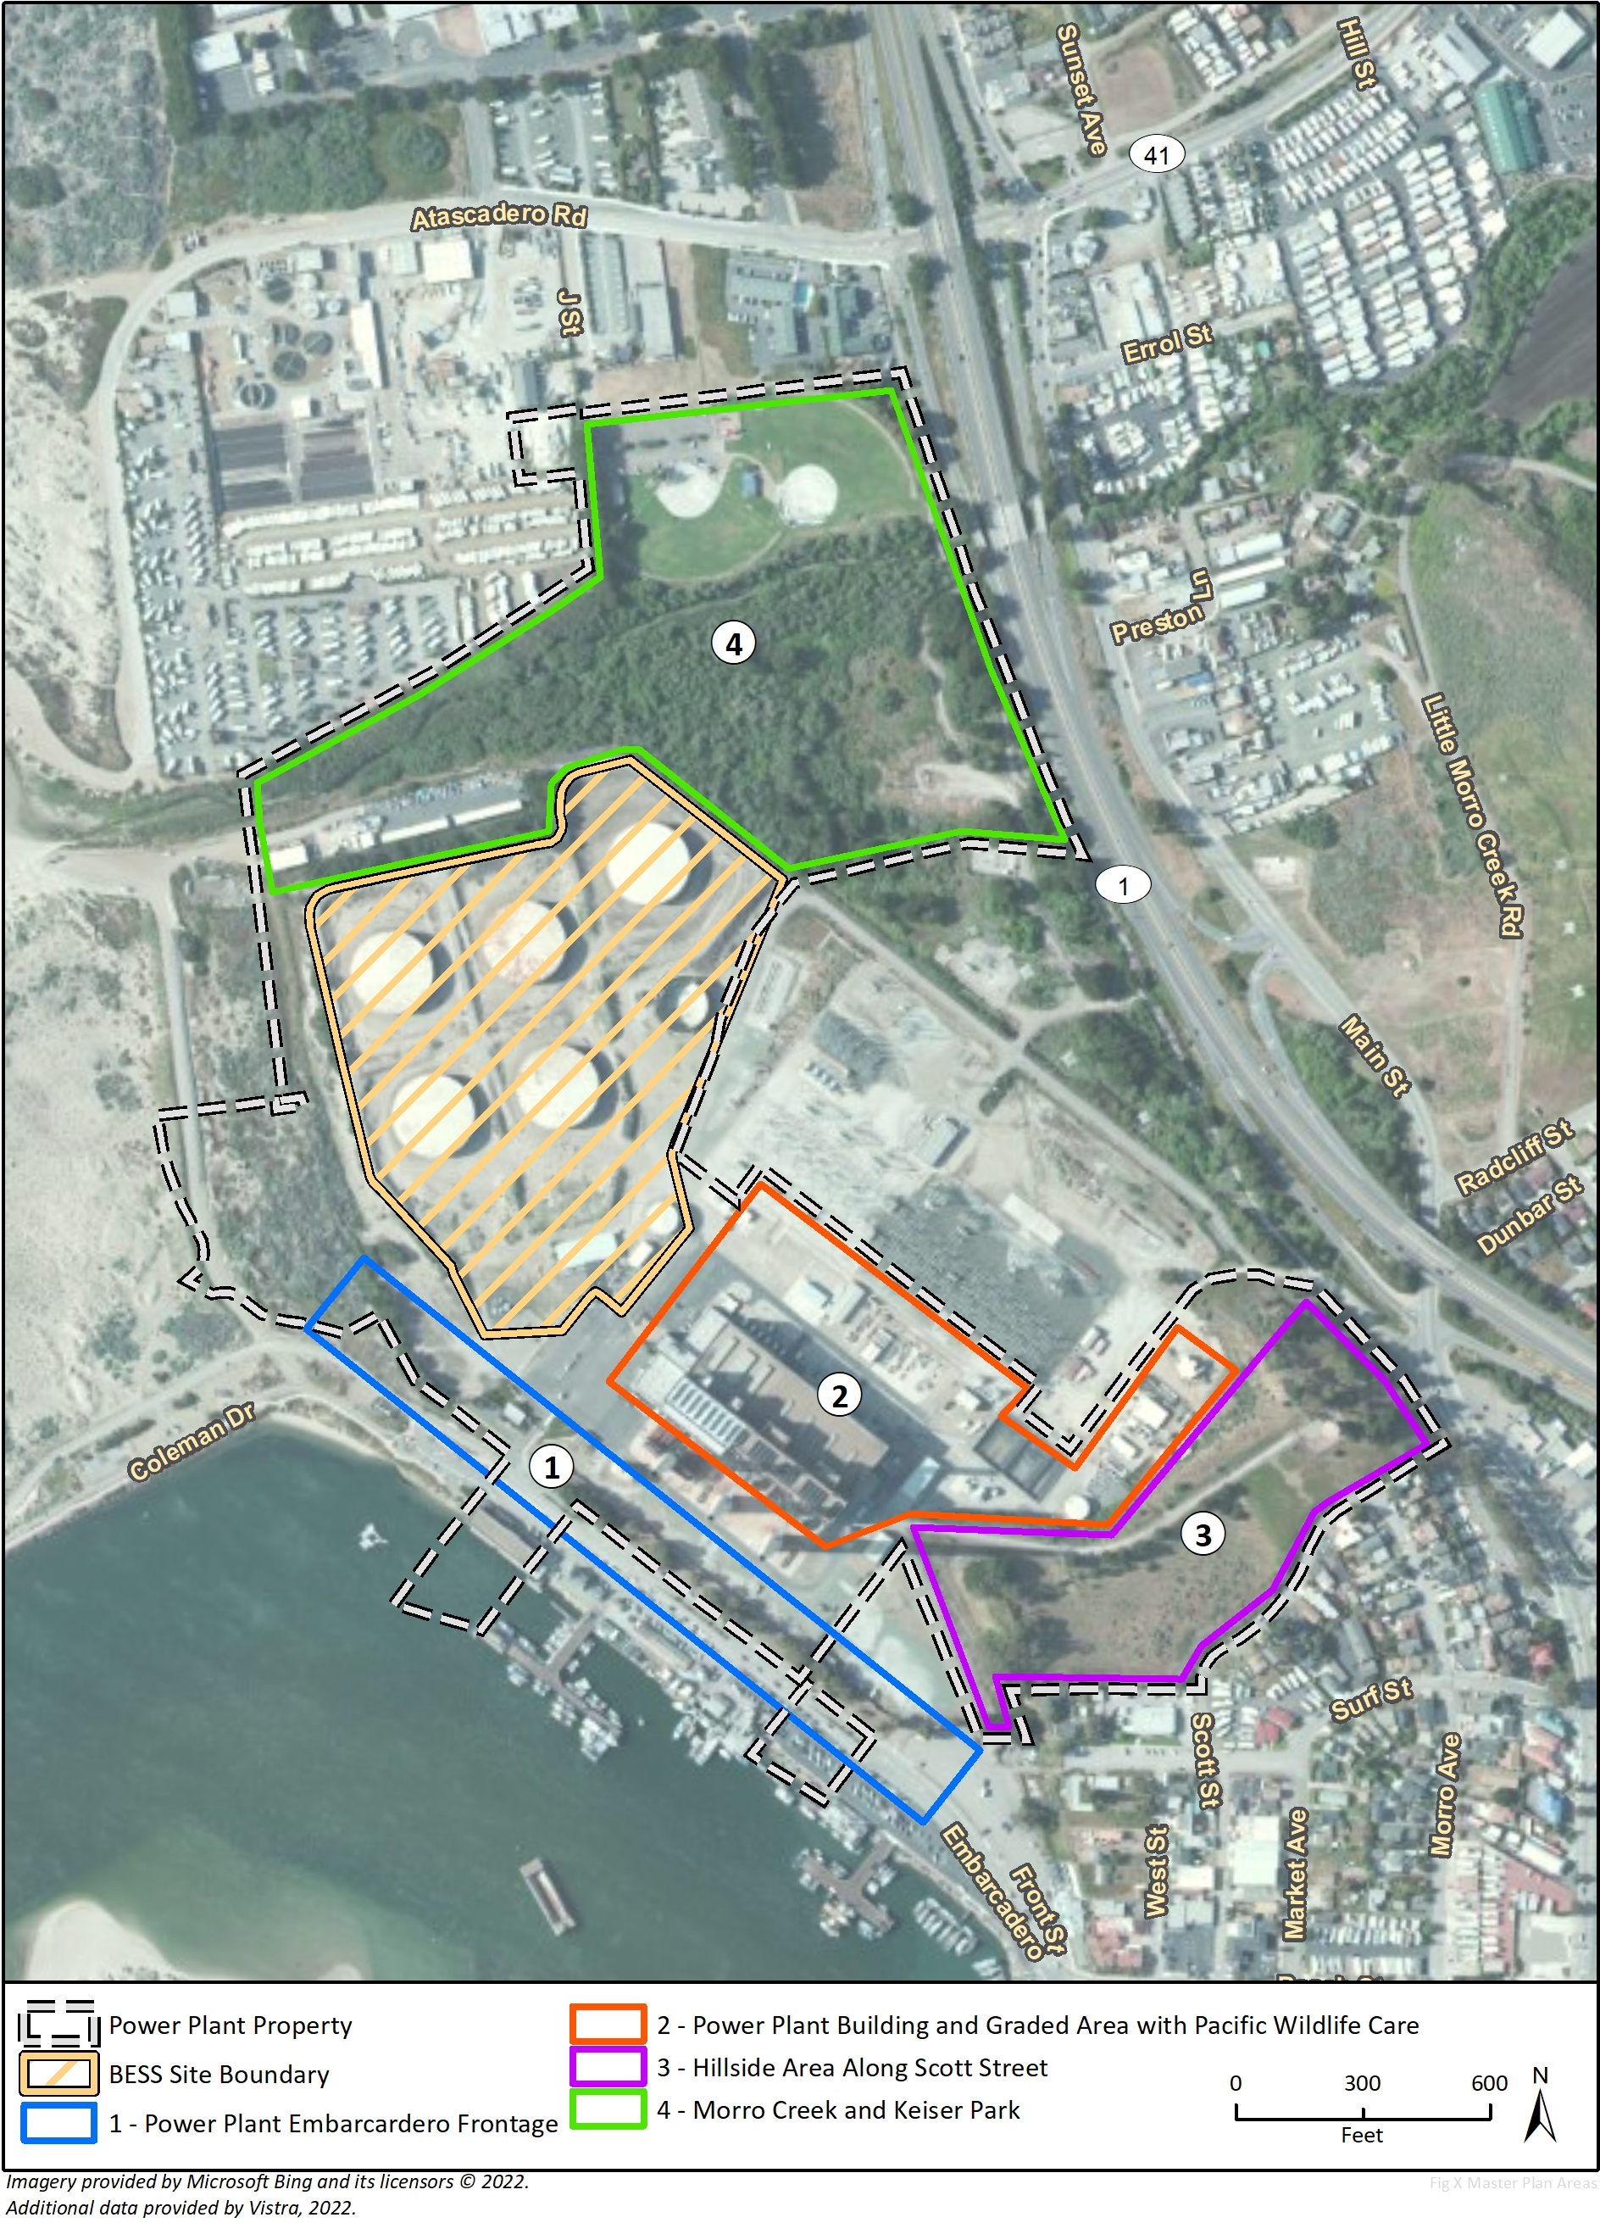
Power Plant Property Master Plan
A requirement of PMB Policy LU-5.4: Vistra Site Master Plan.
This phase of the Master Plan being prepared to establish vision for Power Plant Property and recommend improvements to pedestrian and circulation connections.
Potential impacts of the MP evaluated programmatically in Draft EIR, building on analysis for buildout of the Power Plant Property in the 2021 Final EIR for the General Plan and LCP Update

Slide 11
CEQA Overview
The California Environmental Quality Act (CEQA) is the State’s primary environmental protection law
CEQA requires that public agencies disclose environmental impacts of projects that have a physical effect on the environment

Slide 12
What is an EIR?
An Informational Document
Discloses information about the negative or positive effects a proposed project may have on the environment
Identifies mitigation measures to reduce a project’s potential impacts on the environment
Describes feasible alternatives to the proposed project
Final EIR must be certified prior to project approval

Slide 13
The EIR Process
Responsible agency decision-making bodies consider the Final EIR
Lead agency prepares Initial Study
Lead agency sends Notice of Preparation to responsible agencies
Lead agency prepares Draft EIR
Lead agency files Notice of Completion & gives public Notice of Availability of draft EIR
Public review period (45 days minimum, 78 days in this case)
Lead agency prepares Final EIR, including response to comments on the Draft EIR
Lead agency prepares finding on the feasibility of reducing significant environ-mental
effects
Lead agency makes a decision on the project
Lead agency files a Notice of
Determination with County Clerk
Lead agency solicits comment from agencies & public on the scope and content of the Draft EIR
Lead agency solicits comment from agencies & public on the adequacy of the Draft EIR
Current Phase:
Opportunities for Public Input:

Slide 14
Key Topics in the Draft EIR
The following environmental topics are examined in detail in the Draft EIR:
Aesthetics and Visual Resources
Air Quality
Biological Resources
Cultural Resources and Tribal Cultural Resources
Geology and Soils
Geology and Soils
Greenhouse Gas Emissions
Hazards and Hazardous Materials
Noise
Transportation

Slide 15
Significant Unavoidable Impacts
Cultural Resources (CUL-1): The project would remove historic structures.
Mitigation required to minimize impacts to the extent possible.
Level-III archival documentation of the MBPP building and boiler stacks by a qualified architectural historian.
On-site interpretive display on the MBPP Property focusing on MBPP history and engineering features.

Slide 16
Mitigated Impacts (1/3)
Biological Resources (special-status plant and wildlife species; riparian habitats; freshwater wetlands and estuarine wetlands; and ESHA)
Pre-construction surveys for special-status wildlife species
Worker Environmental Awareness Program, construction monitoring, and BMPs during vegetation removal, ground disturbing activities, and construction
Avoidance, minimization, and mitigation measures for wildlife, sensitive natural communities, and ESHA
Habitat Mitigation and Monitoring Plan

Slide 17
Mitigated Impacts (2/3)
Air Quality (short-term emissions during construction and future decommissioning activities)
SLOAPCD Standard Measures for Construction Equipment and U.S. EPA Tier 4 Construction Equipment
Cultural Resources and Tribal Cultural Resources (potential to impact previously undiscovered archaeological resources and tribal cultural resources)
Cultural resource protection measures (Master Plan)
Construction Monitoring Treatment Plan & Worker Environmental Awareness Program
Construction monitoring by a qualified archaeologist and a Native American representative
Potential Phase III Data Recovery Excavations, if required

Slide 18
Mitigated Impacts (3/3)
Geology and Soils (seismically induced geologic hazards; expansive soils; and potential to impact previously undiscovered paleontological resources)
Geotechnical assessment prepared by a qualified engineer to support design of all building foundations, subgrades, and transportation infrastructure
Worker Environmental Awareness Program; standard discovery measures for paleontological resources
Hazards and Hazardous Materials (exposure of workers and employees to existing soil contaminants)
Remedial actions required by Department of Toxic Substances Control
Soil Management Plan to address potential contamination in AOC 7

Slide 19
Less Than Significant Impacts (1/2)
Aesthetics and Visual Resources
AES-1. Effects on Scenic Vistas
AES-2. Damage to Scenic Resources
AES-3. Visual Character of Public Views
AES-4. Sources of Light and Glare
Air Quality
AQ-1. Consistency with Clean Air Plan
AQ-4. Other Emissions (Odors, NOA)
Cultural Resources and Tribal Cultural Resources
CUL-3. Unidentified Human Remains
Greenhouse Gas Emissions
GHG-1. GHG Emissions
GHG-2. Consistency with Plans, Policies, or Regulations to Reduce GHG Emissions

Slide 20
Less Than Significant Impacts (2/2)
Hazards and Hazardous Materials
HAZ-1. Routine Transport, Use, Storage, and Disposal of Hazardous Materials
HAZ-3. Emergency Response and Evacuation
HAZ-4. Pollutant Release Due to Flood Hazard or Inundation
Noise
NOI-1. Permanent Noise Increases
NOI-3. Groundborne Vibration
Transportation
TRA-1. Planned Transportation Improvements in the Plan Morro Bay Circulation Element
TRA-2. New Vehicle Travel (Vehicle Miles Traveled)

Slide 21
Project Alternatives (1/2)
CEQA requires a “reasonable range” of alternatives
Intended to address impacts identified in the EIR
Must generally meet project objectives
Intended primarily to show conceptual ways to address possible impacts

Slide 22
Project Alternatives (2/2)
Alternative 1: No Project
Alternative 2: Plan Morro Bay Consistency
Alternative 3: BESS Facility Without Demolition
Alternative 4: Reduced BESS Facility
Alternative 5: Enclosure-Based BESS Facility
Alternative site designs and off-site project locations are inconsistent with project objectives
Former tank farm site subject to DTSC Limited Use Covenant
No other property in Morro Bay with similar characteristics to support a BESS facility
Applicant does not own or control other properties that would offer a feasible alternative location

Slide 23
Comments on the Draft EIR
Receive public comments on:
Impacts of the proposed project
Technical issues addressed in the Draft EIR
Impacts related to the proposed project
Proposed mitigation measures
Other aspects of the Draft EIR
Focus comments on the DEIR findings rather than opinions on the merits of the project

Slide 24
Next Steps
78-day public comment period on Draft EIR ends Tuesday, May 28, 2024
Final EIR will be prepared responding to public comments
Planning Commission and City Council to review Final EIR findings alongside review of the project

Slide 25
How to Submit Your Comments
How to Submit Your Comments on the Draft EIR
Submit Comments by midnight Tuesday, May 28, 2024
Possible ways to submit comments:
Speak or submit a written comment at tonight’s meeting
Write a letter or email to the City, addressed to:
City of Morro Bay
Attn: Kim Fowler, Interim Planning Manager
955 Shasta Avenue
Morro Bay, California 93442
email: BESScomments@morrobayca.gov

